Slide 1
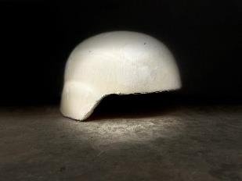
Helmet document
Strictly confidential shared under NDA

Slide 2
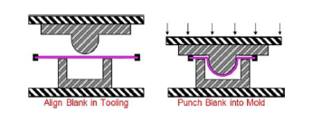
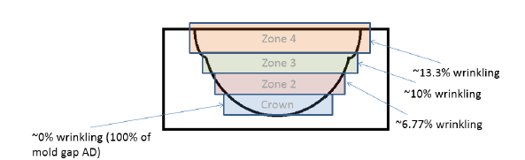
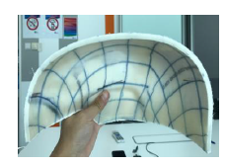
Read me first
Ballistic helmet is made from a stack of multiple composite sheets. DSM Protective Material (DPM) produces composite sheet material but not ballistic helmet. In order to provide technical support our customers and end users to use DPM’ composite material for helmet application, the Innovation team is tasked to develop know-how on how to mold composite material into ballistic helmet.
The manufacturing process is called Deep Drawn compression molding where the material stack is consolidated with presence of temperature and pressure. The typical temperature and pressure used in the process range from 125-145ºC and 165-300bars respectively. Both temperature and pressure would influence helmets’ performance. Refer to Ref 1.
When designing a helmet from DPM Unidirectional (UD) composite material, there are several aspects that require attentions which are related to the material and the manufacturing process:
Formation of wrinkling. DPM UD materials have high in plane stiffness, they are difficult to drape without applying high forces on the stack. The formation of two-dimensional to three-dimensional therefore results in the formation of wrinkles already very early in the process. This wrinkles causes overlap of material that takes place, in fact doubling and tripling the amount of material at certain locations, in the mold. The folded areas get bigger at the edge of the helmet versus the crown, hence there will be a thickness gradient over the helmet area. Refer to Ref 2
Shearing on the +/-45 axis. UD materials at +/-45 axis are being stretched during the manufacturing process. This stretching and elongating is also known as Trellis. It will change the 0/90 fiber orientation of the material. This change in fiber orientation is accompanied with locally increased thickness of the UD material. This thickness increase is biggest at the edge of the helmet (more trellis).
Both wrinkling and trellis effect cause increased thickness at the helmet and will need to be compensated by adding filler plies. The filler plies need to be chosen such that the pressure distribution and thickness of a helmet become as uniform as possible. This is crucial for the helmet performance. Refer to Ref 3.
We typically use filler plies in following shape: circle, circle cross, cross, together with square plies. The size of filler ply is dependent on material, performance requirement and helmet mold shape. The ratio between square plies and filler plies is dependent on material and helmet mold shape. Typically it is around 3: 1 (the ply counts of square plies : the ply counts of filler plies)
The typical ballistic test we do to evaluate homogeneity of a helmet design is called FSP test. We conduct (no less than) 8 shots around helmet perimeter. If the projectile is stopped by helmet, we call this shot as “stop”; if the projectile is penetrated, we call this shot as “penetration”. Then after we determine a value called V₅₀ value as average of 3 highest “stop” velocity and 3 lowest “penetration” velocity. This test is called Ballistic Limit test in the international ballistic testing standard. Higher the V₅₀ better the performance. V50 value is dependent on material, design, and shot location.
Ref1: Deep Drawn molding
Ref2: example wrinkling and mold filling
Ref3: unform helmet achieved by adding filler plies

Slide 3
Design steps
Steps/results
Rationale/design thinking
To be added later

Slide 4
Understanding and performance interpretation steps
Shearing
Shear angle on helmet
Visual
Light-table inspection
Quantitative knocking inspection as a sound check for its uniformity
3D thickness profiling
Thickness distribution
Prediction of thickness increase due to shearing
Thickness comparison between shearing and wrinkling areas
In-house testing
Fragment V50 – implication of consolidation
BFD against bullet threats
Ear-to-Ear rigidity
Correlation between actual thickness vs thickness predicted by measured shear angle
Preliminary assessments (non-destructive)
Ultimate assessments

Slide 5
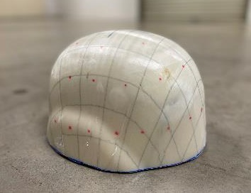
Recipe based on Square ply and Circle ply
33 plies at crown
33 plies
27 plies at lower circumference
32 plies
31 plies
29 plies
D=360mm
D=310mm
D=260mm
D=210mm
D=160mm
27 plies
25 plies
25 plies | 2 plies | 2 plies | 2 plies | 1 plies | 1 plies
To fill up the mold gradually
This recipe has V₅₀ of 715m/s

Slide 6
Stacking sequence
Filler plies
Pic is meant for illustration purpose

Slide 7
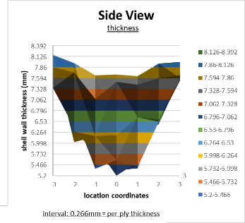
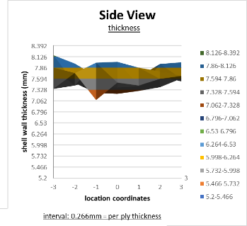
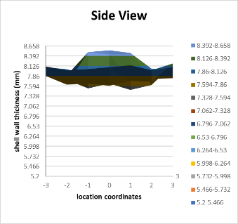
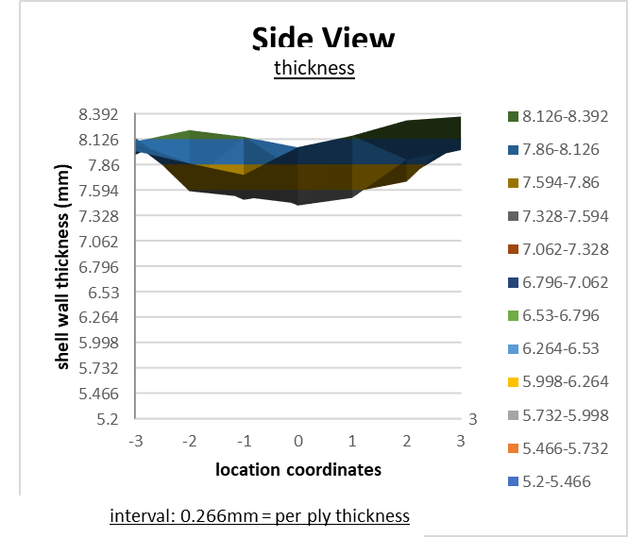
Before vs after adding filler plies
Before adding filler plies
After adding filler plies
Helmet shell#28 | From the helmet shell#4, we observed that the 8mm-thick mold is underfilled so that we added more filler plies and based on more gradual-change diameters. But we are now overfilling the mold which we will take 1 ply each out from D=210mm and D=160mm circles
25 square ply
2 ply D=360mm
2 ply D=300mm
2 ply D=260mm
2 ply D=210mm
2 ply D=160mm
Helmet shell#29 | From the helmet shell#28, we observed that the 8mm-thick mold is overfilled at the crown area so that we took 1 ply each out from D=210mm and D=160mm circles. It turns out the thickness at lower circumference is around 8mm but crown became 7.5mm
25 square ply
2 ply D=360mm
2 ply D=300mm
2 ply D=260mm
1 ply D=210mm
1 ply D=160mm
Helmet shell#4 | From the helmet shell#2 thickness measurement, we estimated that in order to fill the crown to be 8mm thick, we probably need 8 filler plies i.e. total ply counts at crown is 33 plies
24 square ply
3 ply D=360mm
2 ply D=280mm
2 ply D=200mm
1 ply D=160mm
Helmet shell#2 | This step is to find out how many big ply is needed in order to fill 8mm mold at lower circumference area
24 square ply
V₅₀=684m/s
V₅₀=706m/s
V₅₀=715m/s

Slide 8
Ballistic performance comparison
8mm HB30 helmet shell#4
8mm HB30 helmet shell#29
Shot # | Velocity (m/s) | S/P | Shot location (axis)
1 | 650 | S | 0 (6.5cm from edge)
2 | 692 | P | 90 (6.5cm from edge)
3 | 687 | P | 180 (6.5cm from edge)
4 | 666 | P | 270 (6.5cm from edge)
5 | 641 | S | 45 (6.5cm from edge)
6 | 685 | S | 135 (6.5cm from edge)
7 | 726 | S | 225 (6.5cm from edge)
8 | 752 | P | 315 (6.5cm from edge)
Shot # | Velocity (m/s) | S/P | Shot location (axis)
1 | 666 | S | 0 (8cm from edge)
2 | 700 | P | 90 (8cm from edge)
3 | 666 | S | 180 (8cm from edge)
4 | 677 | P | 270 (8cm from edge)
5 | 666 | S | 45 (6.5cm from edge)
6 | 702 | S | 135 (6.5cm from edge)
7 | 751 | S | 225 (6.5cm from edge)
8 | 798 | P | 315 (6.5cm from edge)
9 | 763 | S | 315 (13cm from edge)
10 | 789 | P | 90 (13cm from edge)
11 | 756 | P | 225 (13cm from edge)
12 | 736 | P | Crown
V₅₀ test result against 1.1g FSP
Only eight locations were tested
V₅₀ test result against 1.1g FSP
12 shots were conducted
V₅₀ based on 3 lowest CP and 3 highest PP = 684m/s
V₅₀ based on 3 lowest CP and 3 highest PP = 715m/s

Slide 9
Pictures of helmet shell #29 after test
FRONT VIEW
SIDE VIEW
BACK VIEW
Before Test
Shot # | Velocity (m/s) | S/P | Shot location (axis)
1 | 666 | S | 0 (8cm from edge)
2 | 700 | P | 90 (8cm from edge)
3 | 666 | S | 180 (8cm from edge)
4 | 677 | P | 270 (8cm from edge)
5 | 666 | S | 45 (6.5cm from edge)
6 | 702 | S | 135 (6.5cm from edge)
7 | 751 | S | 225 (6.5cm from edge)
8 | 798 | P | 315 (6.5cm from edge)
9 | 763 | S | 315 (13cm from edge)
10 | 789 | P | 90 (13cm from edge)
11 | 756 | P | 225 (13cm from edge)
12 | 736 | P | Crown
V₅₀ based on 3 lowest CP and 3 highest PP = 715m/s

Slide 10
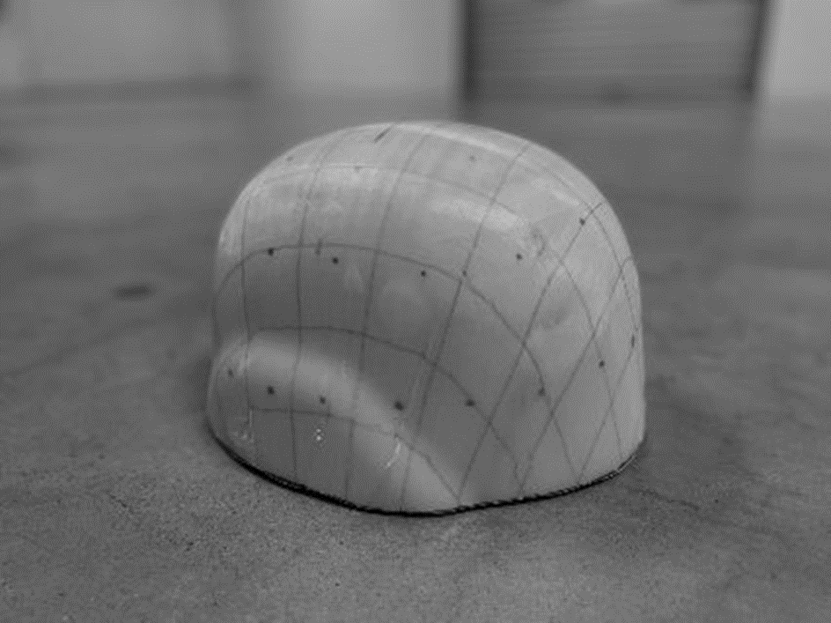
Understanding of shearing HB30 vs HB26
At same pressing condition, HB30 probably tends to thicken more comparing to HB26 i.e. meaning more shearing at those [+/-45] axis
HB30 helmet shell
θ=80º little thickening
θ=57º thicken x1.2
θ=47º thicken x1.4-1.5
^ press pad study e.g. helmet pressed with assist of a press pad will be able to counter check this result

Slide 11
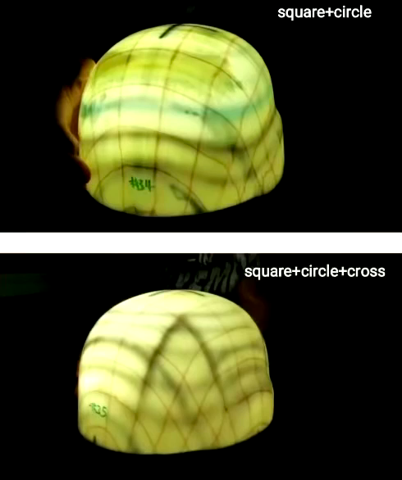
Light-table comparison between recipes
What is multiple filler shape for:
When recipe is based on square and circle plies, the V₅₀ has high and low areas in the helmet (e.g. in our case, [+/-45] areas have higher V₅₀ than 0/90 areas). In order words, this is the limitation of the recipe based on square and circle plies (symmetric mold filling).
Technically, the idea to use filler ply in different shape such as cross is to unify the V₅₀ via having a more homogenized mold filling. Fundamentally, UD material deforms differently at [0/90] and [+/-45] axis. This is because fibers are orientated at [0/90] (but not [+/-45]). Such different extent of deformation results to thickness variation. So we use the ply shape and ply counts to strategically engineer the forming in order to achieve uniform consolidation.
Experiment:
Two HB30 helmet shells are compared to each other under the light-table
Recipe based on square + circle
V₅₀=710m/s, mean error=8.5
Recipe based on square + circle + cross
V₅₀=680m/s, mean error=7.6

Slide 12


